Slide 1
LEADERSHIP COMPETENCIES 101
I Facilitator Guide

Slide 2

TABLE OF CONTENT
Introduction
03
Session Introduction
06
Al Futtaim Leadership Model
17
Game Set-up & Rules
22
Session Debrief
31
Answer Sheet – Executive Version
34
Answer Sheet – Leadership Version
39
Notes:
Video instructions be simpler

Slide 3
INTRODUCTION
Session Details
Session Name: Leadership Competencies 101
Session Duration: 3 Hours
Targeted Audience: Al Futtaim Leaders
Levels (G&H – I &J – K&L)
Session Objective:
By the end of this gameplay, participants will be able to:
Recognize Al Futtaim’s 8 core competencies
Identify and paraphrase the description of the competencies
Be able to explain each competency with examples for their teams.
Learn to apply competencies in various contexts to enhance self-development, team development, performance management, and succession planning.
Propose actionable plans to enhance their competency levels, incorporating measurable goals and specific steps for improvement.
Utilize the core competencies to evaluate and provide feedback on individual and team performance, enhancing performance management practices.
Identify and nurture potential leaders based on their competency alignment.

Slide 4
INTRODUCTION
Workshop Structure
This guide provides a detailed roadmap for facilitating the workshop, including:
Session Introduction: Briefly introduce yourself, the learning objectives of the workshop, and how this game-based session fits into the overall program.
Al Futtaim Leadership Model: Provide a concise overview of the key elements of the Al Futtaim Leadership Model to create a strong foundation for the game.
Game Set-up & Rules: Here, you'll detail the steps for setting up the game environment, materials needed, and explain the game rules clearly.
Session Debrief: Following the game, dedicate time for a facilitated discussion to debrief the experience, analyze player actions, and connect learnings back to the Al Futtaim Leadership Model.
By the conclusion of this session, participants will be equipped with a clear understanding of our Leadership Competency Framework and a personalized roadmap for further honing their leadership skills.

Slide 5
INTRODUCTION
Welcome to the session on Al Futtaim Leadership Competency Framework!
This guide equips you to deliver a comprehensive and engaging workshop that explores the core competencies essential for successful leadership within our organization.
What Leaders Need Today
The landscape of leadership is constantly evolving, demanding a new breed of leaders who can navigate complexity, drive innovation, and foster high-performing teams. Our Leadership Competency Framework outlines the key behaviors and skills our leaders need to thrive in this dynamic environment.
Benefits of this Session
Through this workshop, participants will gain a thorough understanding of the Leadership Competency Framework. They will:
Display the core competencies that define effective leadership within Al Futtaim.
Engage in interactive games designed to solidify their understanding and application of the framework.
Develop a personalized action plan to further develop their leadership capabilities.

Slide 6
SESSION INTRODUCTION
How Al Futtaim Automotive Competencies and Model Drive Success
Slides 1 – 4
Introduction & Welcome:
Begin by introducing yourself, your role, and your excitement to facilitate this session.
Briefly thank the participants for their time and express your enthusiasm for their participation.
Example:
"Hi everyone, I'm [Your Name] and I'm thrilled to be here today to learn about the Al Futtaim Leadership Model with you all. As a facilitator, I'm passionate about creating engaging learning experiences, and this session is no exception!"
Illustrating Session Agenda:
Highlight Key Modules: Briefly introduce each of the four modules using the bullet points you created:
Module 1: "What is a Leadership Competency Framework?"
Module 2: "What is the Al Futtaim Leadership Model?"
Module 3: "Board Game: Leadership Competencies 101“
Module 4: "How Will I Apply the Al Futtaim Leadership Competencies?"

Slide 7
SESSION INTRODUCTION
How Al Futtaim Automotive Competencies and Model Drive Success
Slide 5
Setting the Context:
Ask a thought-provoking question to engage the group, such as: "What are some of the key qualities of a strong leader?" or "How can effective leadership contribute to a company's success?"
Briefly discuss the importance of strong leadership in today's dynamic business environment.
Explain that this session will focus on the Al Futtaim Leadership Model, a framework designed to cultivate well-rounded leaders within the Al Futtaim Group.
The Power of Gamified Learning:
Explain that today's session will utilize a game-based approach to explore the Al Futtaim Leadership Model in a fun and interactive way.
Briefly highlight the benefits of gamified learning, such as increased engagement, improved knowledge retention, and fostering collaboration.

Slide 8
SESSION INTRODUCTION
How Al Futtaim Automotive Competencies and Model Drive Success
Slide 6
Workshop Objectives & Learning Outcomes:
Refer to session objectives in page 3.
Start asking the participants for their expectations from the session and then reflect by illustrating session objectives
Example
Self-Awareness and Growth: Some participants might be particularly interested in self-assessment and development. They might expect tools and techniques to assess their own competency levels and create actionable improvement plans.
Leadership Development Champions: A portion of the group might be leaders or those aspiring to leadership roles. They might be particularly interested in using the competencies to evaluate and provide feedback to their teams, fostering stronger performance management practices and identifying future leaders based on competency alignment.

Slide 9
SESSION INTRODUCTION
How Al Futtaim Automotive Competencies and Models Drive Success
Slide 6
Introduction to Competency Frameworks and Leadership Models:
Start the conversation with engaging questions
Engaging Question: "In today's dynamic automotive industry, what are some key challenges you face as leaders?" (Allow a few minutes for responses and acknowledge answers briefly.)
After reflection, Briefly highlight the importance of Al Futtaim Automotive's established competencies in achieving success.
At Al Futtaim Automotive, we take pride in our established competencies. They guide us in delivering exceptional performance and maintaining our leading position in the market."
Explain that the Leadership Model as a competency framework outlines the skills and knowledge needed for success, and provides a roadmap for developing effective leadership behaviors."
Encourage active participation and emphasize the value of shared experiences.
Example: I encourage you to actively participate and share your insights. Your leadership experiences within Al Futtaim Automotive are invaluable, and your interaction will enrich our discussion and learning.“
Acknowledge Al Futtaim Automotive's ongoing journey: Briefly mention that Al Futtaim Automotive is actively working on raising awareness and knowledge of the established competencies and their various applications.

Slide 10
SESSION INTRODUCTION
Introducing Leadership Competency Framework
Transition from slide 6 to slide 7
Important to highlight in the introduction:
Set expectations and transparency: Be transparent about the ongoing process of embedding these competencies into employee lifecycle touchpoints, acknowledging that this process is still under development.
Example:
"As you know, Al Futtaim Automotive is committed to excellence, and a crucial part of that commitment is our established set of competencies. Today, we'll be exploring these competencies in more detail. It's important to acknowledge that we're currently on a journey to both raise awareness and knowledge of these competencies and their applications across various aspects of our work. We're also actively working on embedding them into different touchpoints throughout the employee lifecycle. While this process is ongoing, today's session will equip you with a strong understanding of these competencies and their potential to empower your leadership journey within Al Futtaim Automotive."
To introduce the Leadership Competency Framework and its importance prepare the following quotes carefully.

Slide 11
SESSION INTRODUCTION
Quote - 1
Slide 7
Quote: “A recent industry trend survey of CEOs found that only 11% of organizations report having a strong enough bench to fill leadership roles” -CCL, 2022
Objective: Emphasize the importance of having Competency model in creating a pool for fulfilling leadership roles.
Talking points:
Introduce the quote: Briefly mention the source and year of the quote.
Explain the key message: Paraphrase the quote in simpler terms, highlighting the connection between having a leadership model or framework and prepping new and existing leaders with the right behaviours and skills to thrive in their leadership role in Al Futtaim.
Application within Al Futtaim: Briefly connect the concept to Al Futtaim Automotive.
A clear role model or a leadership competency framework can define desired leadership behaviors. These frameworks outline the specific skills, knowledge, and attributes that successful leaders in your organization should possess. This shared understanding of "good leadership" benefits all levels and departments.

Slide 12
SESSION INTRODUCTION
Quote - 2
Slide 8
Quote: “Connecting organization core values and beliefs with the leader’s personal motivators reinforce their passion and ability to influence others. - Deloitte, Leadership Development Solutions: Market Primer, 2020
Objective: Emphasize the importance of aligning personal values with organizational values for effective leadership.
Talking points:
Introduce the quote: Briefly mention the source and year of the quote.
Explain the key message: Paraphrase the quote in simpler terms, highlighting the connection between personal and organizational values for leaders.
Benefits of alignment: Explain the positive impact of this alignment.
Reinforced passion: Mention how alignment strengthens a leader's passion and commitment.
Enhanced influence: Explain how it empowers leaders to influence others more effectively.
Application within Al Futtaim: Briefly connect the concept to Al Futtaim Automotive.
"By fostering an environment where personal values resonate with Al Futtaim Automotive's core values, we empower our leaders to be passionate and influential, ultimately contributing to a more engaged workforce and achieving our strategic goals."

Slide 13
SESSION INTRODUCTION
Quote - 3
Slide 9
Quote: “The research consistently highlights the correlation between effective leadership and business success, including factors such as financial performance and employee engagement.
- Development Dimensions International (DDI): The Global Leadership Forecast
Objective: Emphasize the role of effective leadership in achieving business success
Talking points:
Explain the key message: Paraphrase the quote in simpler terms, highlighting the connection between personal and organizational values for leaders.
"This quote from The Global Leadership Forecast emphasizes the crucial link between a leader’s effectiveness and business success”
Application within Al Futtaim: Briefly connect the concept to Al Futtaim Automotive.
Connect it with the below similar note
Studies often show a correlation between strong leadership competencies and positive organizational performance. (Harvard Business Review)
One of the main areas of success is employee satisfaction and engagement (reflect as well with the below quote
Companies that actively implement training and mentoring initiatives to develop leadership competencies are 3.4 times more likely to be rated as a best place to work. (HR Trends)

Slide 14
SESSION INTRODUCTION
Defining Leadership Competency Framework
Slide 10
Talking points:
Define "leadership competency framework" in clear and concise language, emphasizing its role as a structured guide.
Highlight the key elements of a framework: skills, behaviors, and attributes.
Explain the purpose of the framework: identifying, developing, and assessing effective leadership.
Briefly mention the context-specific nature of leadership competencies, emphasizing the importance of relevance to Al Futtaim Automotive.
Example: . As many of you are already familiar with our established competencies at Al Futtaim Automotive, today we'll delve deeper into how leadership competency frameworks can further enhance our leadership development journey. A leadership competency framework is essentially a structured set of skills, behaviors, and attributes that define what it means to be an effective leader within our specific organization. This framework serves as a valuable guide for identifying the qualities needed to succeed in your leadership roles, fostering development opportunities, and ultimately achieving our strategic goals."

Slide 15
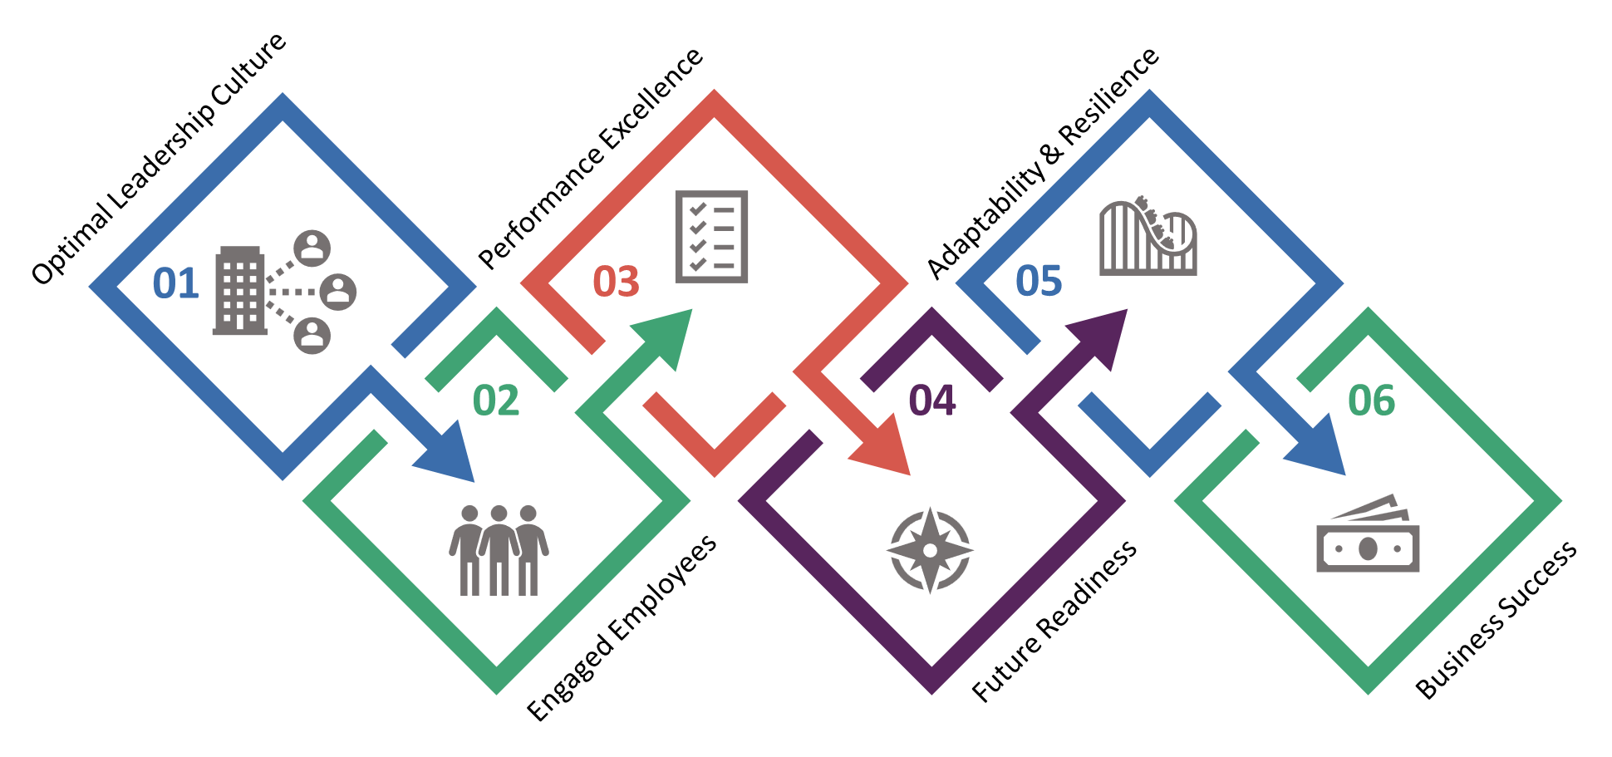
SESSION INTRODUCTION
LEADERSHIP COMPETENCY FRAMEWORK BENEFITS
Slide 11 - 13
Objectives: Summarize after the introduction and the definition of the leadership competency with the below summary.
Companies that actively implement training and mentoring initiatives to develop leadership competencies are 3.4 times more likely to be rated as a best place to work. (HR Trends)
Having Motivated and Engaged employees are a direct impact of having effective leaders in the organization who are skilled and competent.
According to Gallup's State of the Global Workplace report, organizations with engaged employees outperform those without by a significant margin.
Deloitte's annual Human Capital Trends report often emphasizes the critical role of leadership in navigating the challenges of the modern workforce. The 2021 report, for instance, highlights the need for leaders who can be resilient, empathetic, and adaptable.
The research consistently highlights the correlation between effective leadership and business success, including factors such as financial performance and employee engagement.

Slide 16
SESSION INTRODUCTION
Al Futtaim Leadership Model
Slide 14
Objective: Transitioning to illustrate Al Futtaim Leadership Model.
To Link to the illustration of Al Futtaim Leadership model by focusing on the below point.
The leadership competencies are not new to Al Futtaim Group. There were LCs since 2017/2018, however, they have been reviewed, revamped and relaunched in 2022. We are not on a quest to raise awareness and knowledge around them and in parallel work on embedding the competencies in our key employee lifecycle touchpoints (including recruitment, performance mgt, development, and succession planning). This is a journey we’re on.

Slide 17
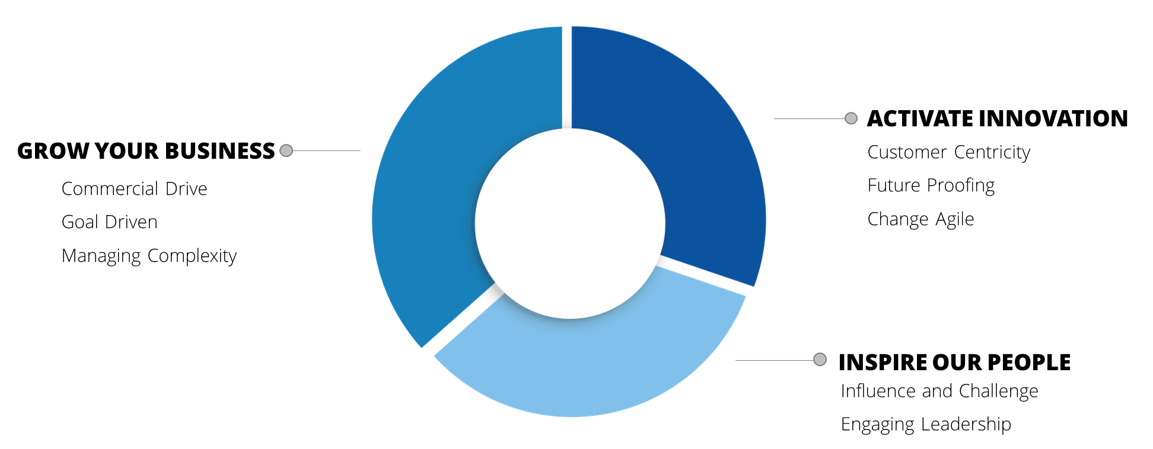
AL FUTTAIM LEADERSHIP MODEL
Al Futtaim Leadership Model
Slide 15
Objective: Introduce Al Futtaim leadership model’s 3 main pillars.
Talking points:
Briefly introduce the slide title: "Our Leadership Model: 3 Pillars."
Point to the image and acknowledge the three pillars: Grow, Innovate, Inspire.
Briefly explain each pillar and its significance in the context of Al Futtaim Automotive's leadership philosophy.
Example: "As you can see on the slide, our leadership model is anchored by three core pillars: Grow, Innovate, Inspire. Focus. These pillars represent the fundamental values and behaviours that guide our leadership approach at Al Futtaim Automotive. Let's start by exploring the first pillar, Authenticity. Authenticity is about being true to yourself and your values, leading with transparency and genuineness. This fosters trust and strengthens relationships within our teams. We then move on to Commitment, which represents dedication and perseverance in achieving our goals. Committed leaders inspire and motivate others, fostering a culture of ownership and accountability. Finally, Customer Focus emphasizes the importance of prioritizing our customers' needs and exceeding their expectations. By keeping the customer at the center of everything we do, we can ensure long-term success and sustainable growth."

Slide 18
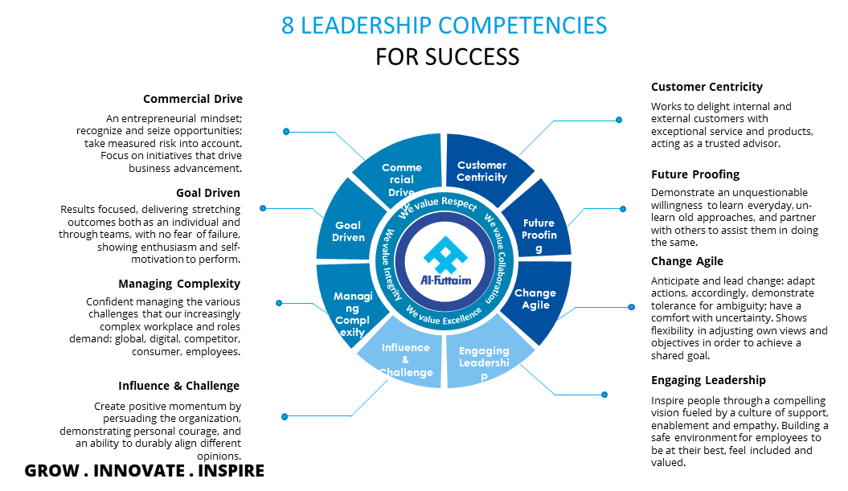
AL FUTTAIM LEADERSHIP MODEL
Al Futtaim Leadership Model
Slide 16 - 25
Objective: Introduce Al Futtaim leadership model’s 8 main competencies.
Talking points:
Briefly introduce the slide title: "8 Leadership Competencies For Success."
Point to the image and acknowledge the competencies and their definitions.
Briefly explain each competency and its significance in the context of Al Futtaim Automotive's leadership philosophy.

Slide 19
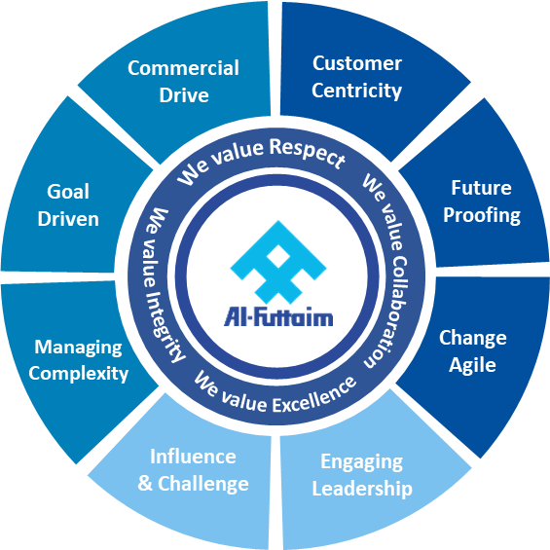
AL FUTTAIM LEADERSHIP MODEL
Al Futtaim Leadership Model
Slide 16 - 25
Objective: Explain that the leadership model is based on Al Futtaim Values
Talking points:
Illustrate that the 8 leadership competencies are built to complement the values model for Al Futtaim.
According to the tagline, the objective of the values model is “enriching every day”.
The vision of Al Futtaim is “ Through the relentless pursuit of excellence, we will enrich the lives of our customers at every turn, as the foremost provider of quality products and services, every day.”
And the Purpose is “ We Provide quality products and services that enrich people’s lives and aspirations each and every day.”
That is done based on the four values which are “Respect, Excellence, Collaboration, Integrity”
Engagement Question:
Discuss with the Participants how the leadership competencies reflect the values of Al Futtaim.

Slide 20
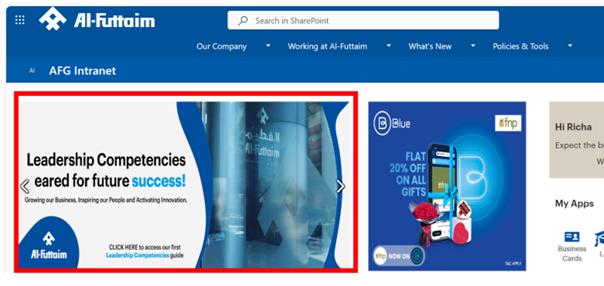
AL FUTTAIM LEADERSHIP MODEL
Where can you find Leadership Competencies?
Slide 26
Objective: Guide the participants to where they can find the Leadership Competency framework.
Activity: Demo for the participants the steps needed to get to the competency framework on Al Futtaim Interanet.
Note. For a better understanding of Al Futtaim Leadership Competency Framework, study the framework before the session.

Slide 21
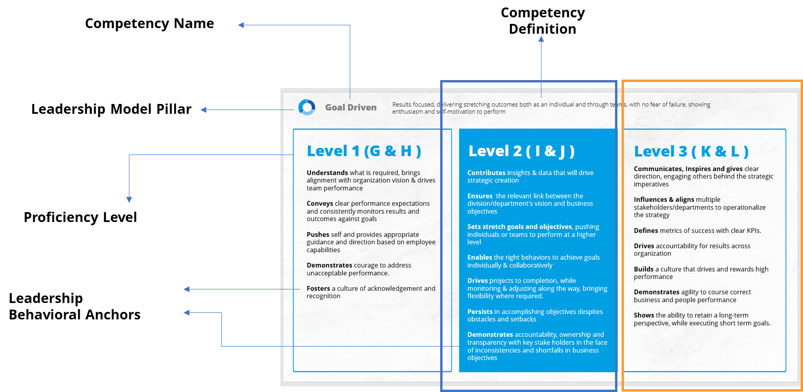
AL FUTTAIM LEADERSHIP MODEL
HOW TO READ THE LEADERSHIP COMPETENCIES FRAMEWORK?
Slide 27 - 28
Objective: Guide the participants to read Al Futtaim Leadership competency Framework.
Activities:
Go through the slide showing the participants the various levels of leadership within Al Futtaim.
Ask participants to read behavioral indicators for their own level.
Discuss with the participants their understanding of those behavioral indicators.

Slide 22
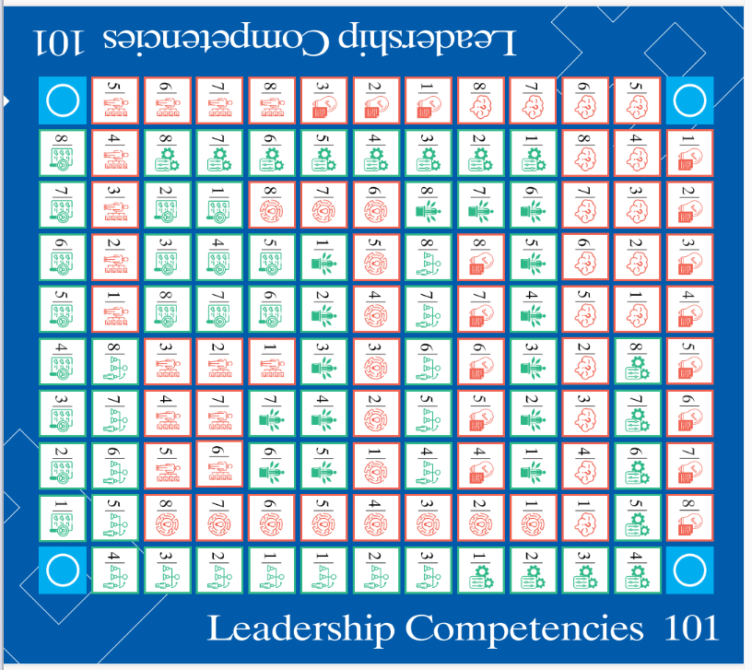

GAME SET-UP & RULES
BOARDGAME PREPARATION & SET UP
Slides 29 - 32
Main Game Set-up
The Game Components:
Board
Card Deck
Game Chips 3 colors (White, Green, Blue)
Begin by laying out the game board on a flat surface, ready for the epic battle of wits and strategy.

Slide 23

GAME SET-UP & RULES
BOARDGAME PREPARATION & SET UP
Slides 30
To Start Illustrating the game to the participants in the session follow the below steps:
Show the participants the video explaining the game.
The video is available in the below QR code.
Go through the rules with the participants one more time.
Do a quick demo run with the participants on the board, then reset the board again to start the game.
Check their understanding

Slide 24






GAME SET-UP & RULES
BOARDGAME PREPARATION & SET UP
Slides 29 - 32
Team Assembly:
The game accommodates 6 to 18 players, Yet for best interactions, we recommend having 12 participants.
If participants are 6-9 participants, divide participants into two teams, each is divided further into two sub-teams.
If 10 – 18 participants, Form three main teams, each divided into two sub-teams.
Alternate positions with your adversaries around the table, this ensures a consistent turn order for each team throughout the round.
WHITE TEAM
GREEN TEAM
Blue TEAM
WHITE Sub-TEAM 1
WHITE MAIN TEAM
WHITE Sub-TEAM 2
6 Players
12 Players

Slide 25
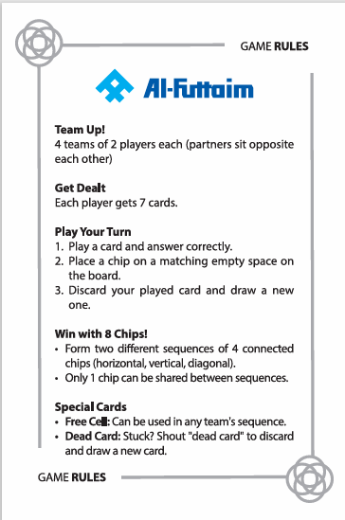
GAME SET-UP & RULES
BOARDGAME PREPARATION & SET UP
Slides 29 - 32
Card and Chips Distribution:
Shuffle the deck with care and deal 7 cards to each Sub-team.
Give each player/ sub-team one Rules card for their usage to remind them of the rules during the game.
Give each sub-team a sufficient number of chips in their team’s color
Then Give the participants 5 minutes for each sub-team to go through the cards dealt and set the strategy for the game.
During those 5 minutes, sub-teams are not allowed to communicate together. Players are only allowed to take within their sub-team.

Slide 26

GAME SET-UP & RULES
MAIN OBJECTIVES & GENERAL RULES
Slides 29 - 32
Game Objective:
The goal is to be the first team to secure 2 sequences on the board, a sequence consists of 4 chips of the same color.
Achieve a sequence by aligning 4 chips either horizontally, vertically, or diagonally on the board.
Participants are allowed to overlap sequences, but they can have only one shared chip between the two sequences.
The four corners of the board as free spaces, that teams can utilize to form sequence.
horizontally
vertically
diagonally
4

Slide 27
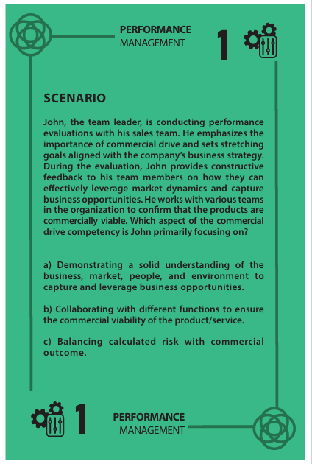
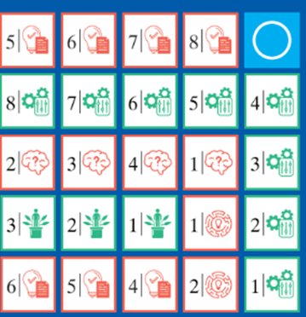
GAME SET-UP & RULES
BEFORE YOU BEGIN!
Slides 29 - 32
Turn-Taking Ritual:
Start from the player to the left of the dealer and move clockwise, taking turns playing cards to each sub-team personal discard pile and placing your team's chip on the board.
Card Play and Chip Placement:
Each sub-team shall play the card to the board on one of two locations, placing your team's chip.
No stacking chips on occupied spaces!
After the chip is placed, the participant shall draw a card promptly. If the participant forgets, they lose the chance to draw, facing the consequences with fewer cards in hand.

Slide 28
GAME SET-UP & RULES
BEFORE YOU BEGIN!
Slides 29 - 32
Silent Precision:
No strategic talks allowed! If a teammate gives away sensitive information, ask them to discard one of their cards.
Deck Resurrection:
If the draw deck runs dry, shuffle all discard piles into a new draw deck.
Special Green and Orange Cards:
Green Cards represent scenarios and require your team's insight into leadership competencies.
Orange Cards present challenges or questions to spice up the game.
Attentive Ears:
Participants must listen to other teams while taking their turnif participants fail to comply, remove one chip from the board for the talking team.
Strategic Huddle:
Take a well-deserved 5-minute break with your sub-team to strategize, contemplate, and plan your next moves based on the dealt cards.

Slide 29



GAME SET-UP & RULES
JOKERS (WILD CARDS)
Slides 29 - 32
Wild Wonders:
Jokers are your wild cards, not making an appearance on the game board.
Green Joker grants the participants the power to place a chip anywhere unoccupied.
Blue Joker empowers the Participants to remove one chip from the board for any other team.
Purple Joker lets you add or remove one chip from the board,
Jokers cannot form any chips from a completed sequence.
Dead Card Strategy:
If you're stuck with a card with both matches covered, shout "dead card," discard it, draw a new card, and continue your turn. But use this tactic wisely – only once per turn.

Slide 30

GAME SET-UP & RULES
DURING THE GAME
Slides 33
During the gameplay, reflect with the participant on each card after the team plays, giving examples and real-life stories to show how can the participants apply the competency framework in their leadership roles in Al Futtaim.
To prepare, kindly go through the card decks available in the QR code below and prepare examples and stories.

Slide 31
SESSION DEBRIEF
HOW WILL WE LEVERAGE THE LEADERSHIP COMPETENCY MODEL?
Slides 35
1. Introduction:
Thank participants for their active participation in the game.
Briefly re-introduce the four main learning takeaways covered in the game.
2. Scenario Card Reflection:
Discuss with the participants the following for a selection of scenario cards encountered during the game:
Specific Competency: Which competency was most relevant to the situation presented in the scenario card?
Decision Making: What decisions did you make as a team to address the scenario? Why did you choose those options?
Competency Application: How did your chosen actions reflect the chosen competency from the Al Futtaim framework?
Learning Points: What key takeaways can be drawn from this scenario regarding effective leadership within the Al Futtaim framework?

Slide 32

SESSION DEBRIEF
Debrief Game
Slide 36
Finally, to recap on all the information that the session discussed, participants are required to complete the debrief game.
Show the slide with the QR code and assist participants to scan the code and answer all the questions.
Activity is in the QR code below

Slide 33
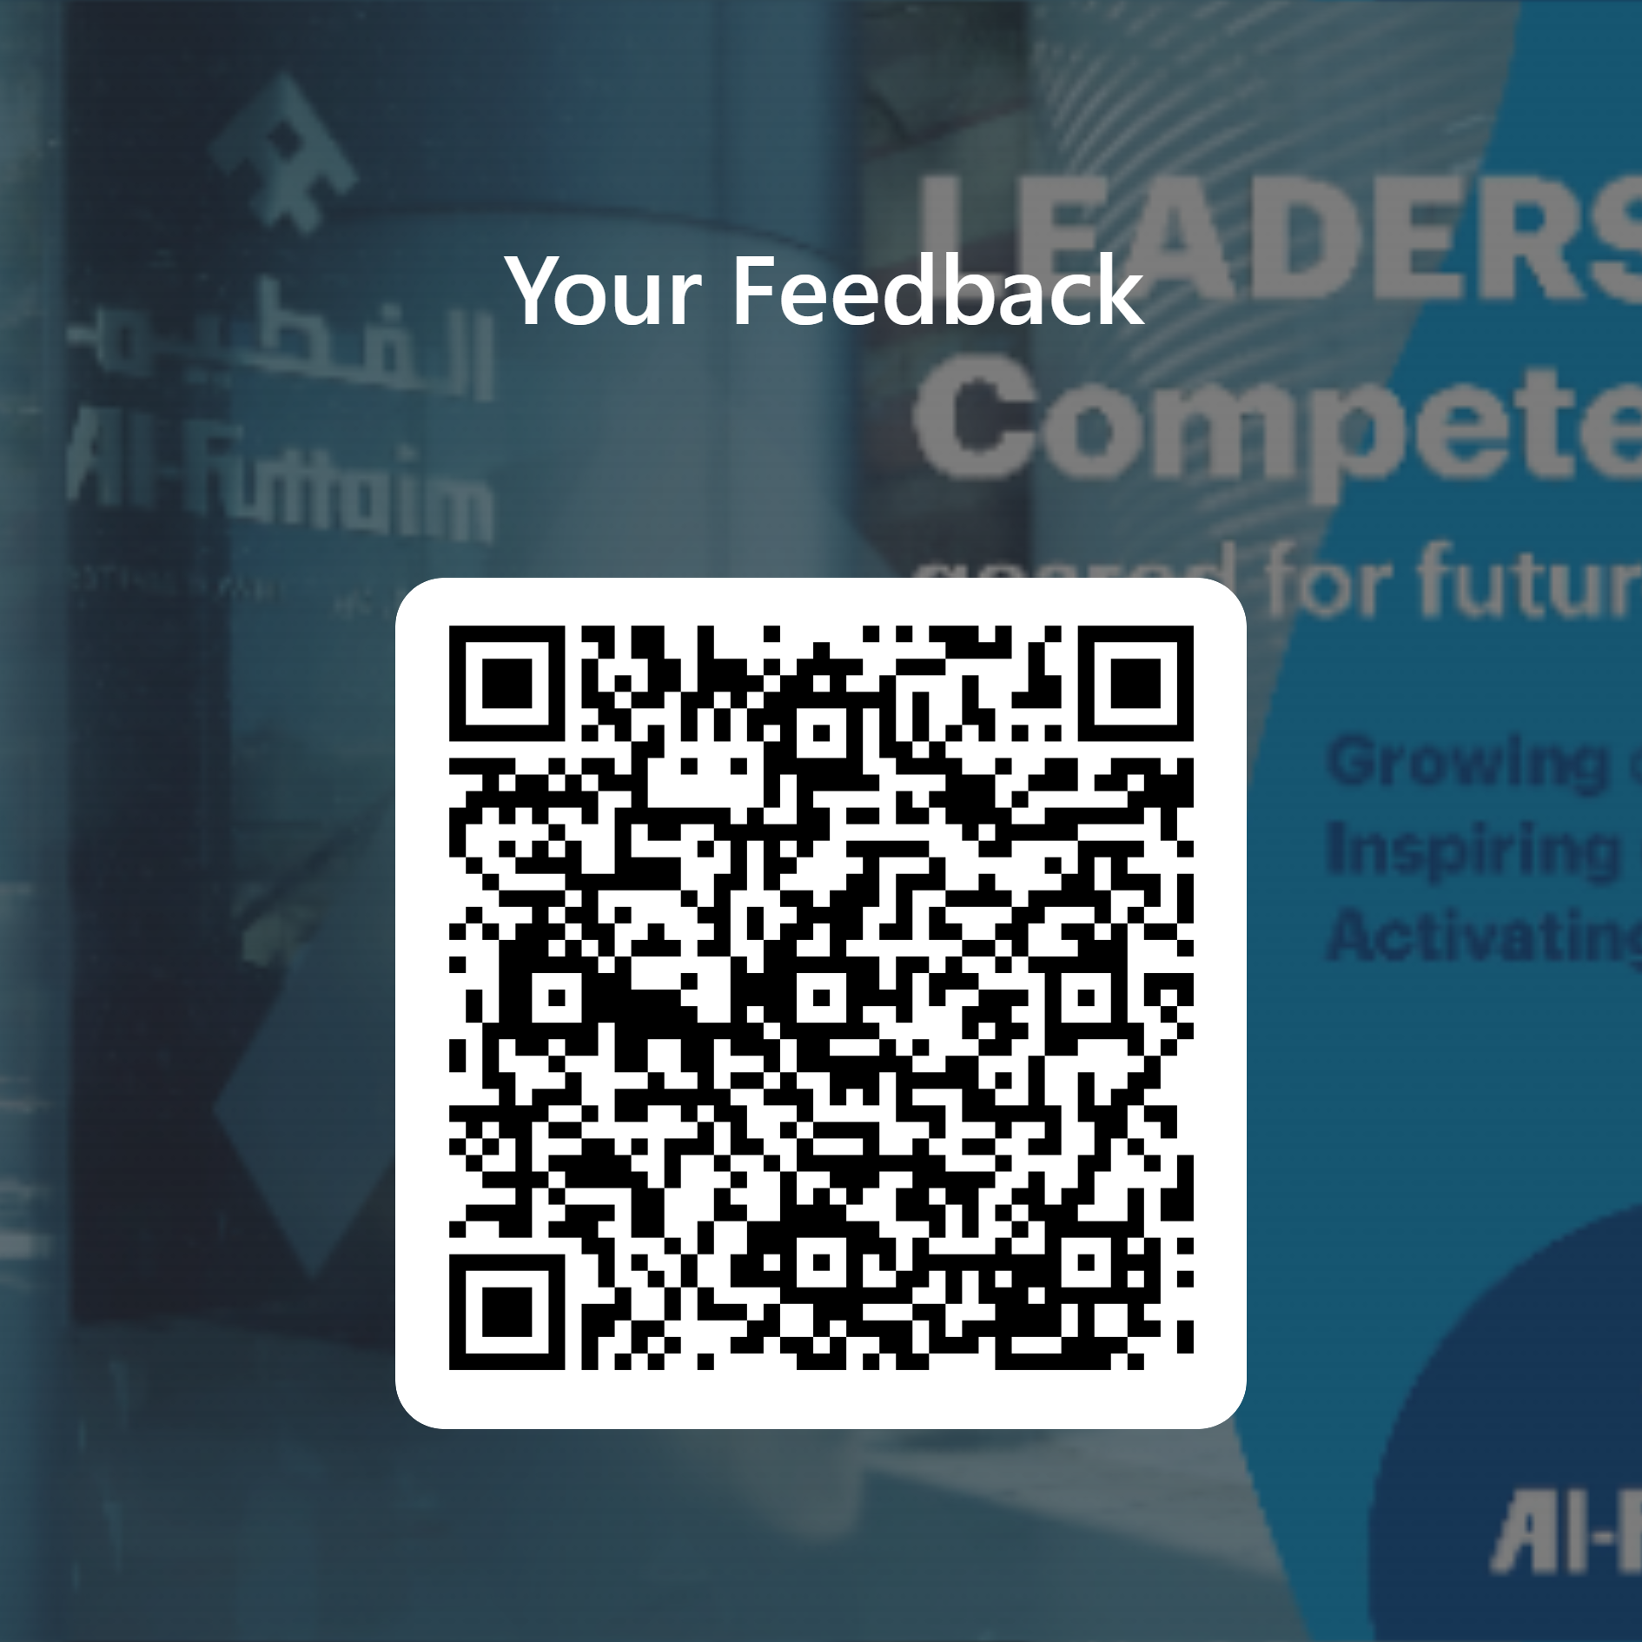
SESSION DEBRIEF
Evaluation
Slide 37
At the end of the session, ask participants to fill the evaluation form online using the below QR code

Slide 34
LEADERSHIP COMPETENCIES 101
I Executive Kit Answer Sheet

Slide 35

FUTTAIM FACTS
1 | 1955
1 | Polestar and BYD
2 | Respect, Excellence, Collaboration, and Integrity
2 | 11 countries across the Middle East, Asia, and Africa
3 | Al Futtaim Trade Point.
3 | Leadership in Sustainability, Leadership in Mobility, Innovation Growth
4 | Polestar
4 | Commercial Vehicles, Passenger Cars, Construction Equipment, Auto Logistics, and agriculture vehicles
5 | Amazon
5 | 44,000+
6 | Al Futtaim Auto Centers
6 | Toyota Land Cruiser
7 | Gold Award in the category of the Best Innovative Sports Brand of the Year award
7 | COP28
8 | Paul Willis
8 | Hino 300 Series Hybrid, Toyota Camry Hybrid, Toyota Prius

Slide 36

TRIVIA
1 | Carl Benz
1 | Nash Motors
2 | Flocken Elektrowagen (1888)
2 | Ford Model T
3 | Toyota Corolla
3 | Italy
4 | totaled approximately 79.4 million units
4 | Ford
5 | Uber
5 | Sports Utility Vehicle
6 | Tesla Model 3 , Nissan Leaf , Chevrolet Bolt EV, BMW i3 , Hyundai Kona Electric , Kia Niro EV , Audi e-tron , Jaguar I-PACE, Ford Mustang Mach-E, Volkswagen ID.4, Porsche Taycan, Volvo XC40 Recharge, Rivian R1T, Lucid Air, Toyota Prius Prime
6 | Honda
7 | China
7 | Anti-Lock Brake System
8 | Ferrari
8 | Ford Mustang

Slide 37


COMPETENCY CHRONICALS
1 | Commercial Drive
2 | Goal Driven
3 | Managing Complexity
4 | Influence and Challenge
5 | Customer Centricity
6 | Future Proofing
7 | Change Agile
8 | Engaging Leadership
BRAVE ENCOUNTERS
A successful challenge is one where the team completes the agreed-upon task within 90 seconds time limit.

Slide 38




SCENARIO CARDS ANSWER SHEET
1 | C
2 | B
3 | A
4 | C
5 | C
6 | C
7 | B
8 | C
1 | B
2 | C
3 | C
4 | B
5 | C
6 | B
7 | C
8 | A
1 | A
2 | C
3 | B
4 | A
5 | B
6 | B
7 | B
8 | C
1 | C
2 | B
3 | B
4 | B
5 | A
6 | A
7 | A
8 | A

Slide 39
LEADERSHIP COMPETENCIES 101
I Leaders Kit Answer Sheet

Slide 40
FUTTAIM FACTS
1 | 1955
1 | Polestar and BYD
2 | Respect, Excellence, Collaboration, and Integrity
2 | 11 Countries
3 | Al Futtaim Trade Point.
3 | Automotive Supply Chain of the Year 2017, ESEA Smart Services Award 2016 for M-Token Services & Innovation Awards 2016 from Dubai Trades as well as the Supply Chain of the Year at the SCATA Awards 2016, Supply Chain of the Year 2015,
4 | Polestar
4 | Commercial Vehicles, Passenger Cars, Construction Equipment, Auto Logistics
5 | 1930
5 | 40 Brands
6 | Al Futtaim Auto Centers
6 | Toyota Land Cruiser
7 | Gold Award in the category of the Best Innovative Sports Brand of the Year award
7 | COP28
8 | The current CEO of Al Futtaim Automotive is Paul Willis
8 | Toyota, Lexus, Honda, CDJR, Volvo ,Polestar, BYD

Slide 41
TRIVIA
1 | Carl Benz
1 | Sport utility vehicle
2 | Ford Motor Company
2 | Toyota Corolla
3 | Wolfsburg, Germany
3 | Bayerische Motoren Werke
4 | Ford Model T
4 | Sedan
5 | 1908
5 | Amazon
6 | Audi
6 | SSC Tuatara
7 | Honda
7 | Chevrolet Corvair Monza and the Oldsmobile Jetfire
8 | The 397.360km/h (246.908mph)
8 | General Motors (GM)

Slide 42
COMPETENCY CHRONICLES
A successful challenge is one where the team completes the agreed-upon task within 90 seconds time limit.
BRAVE ENCOUNTERS
A successful challenge is one where the team completes the agreed-upon task within 90 seconds time limit.

Slide 43
SCENARIO CARDS ANSWER SHEET
1 | B
2 | B
3 | A
4 | C
5 | A
6 | C
7 | B
8 | A
1 | C
2 | C
3 | B
4 | B
5 | C
6 | B
7 | B
8 | B
1 | A
2 | C - D
3 | B
4 | A
5 | B
6 | A
7 | A
8 | B
1 | C
2 | B
3 | B
4 | B
5 | B
6 | C
7 | B
8 | B

